Slide 1

Editing Wikipedia
Kelly Lepo
McGill University

Slide 2
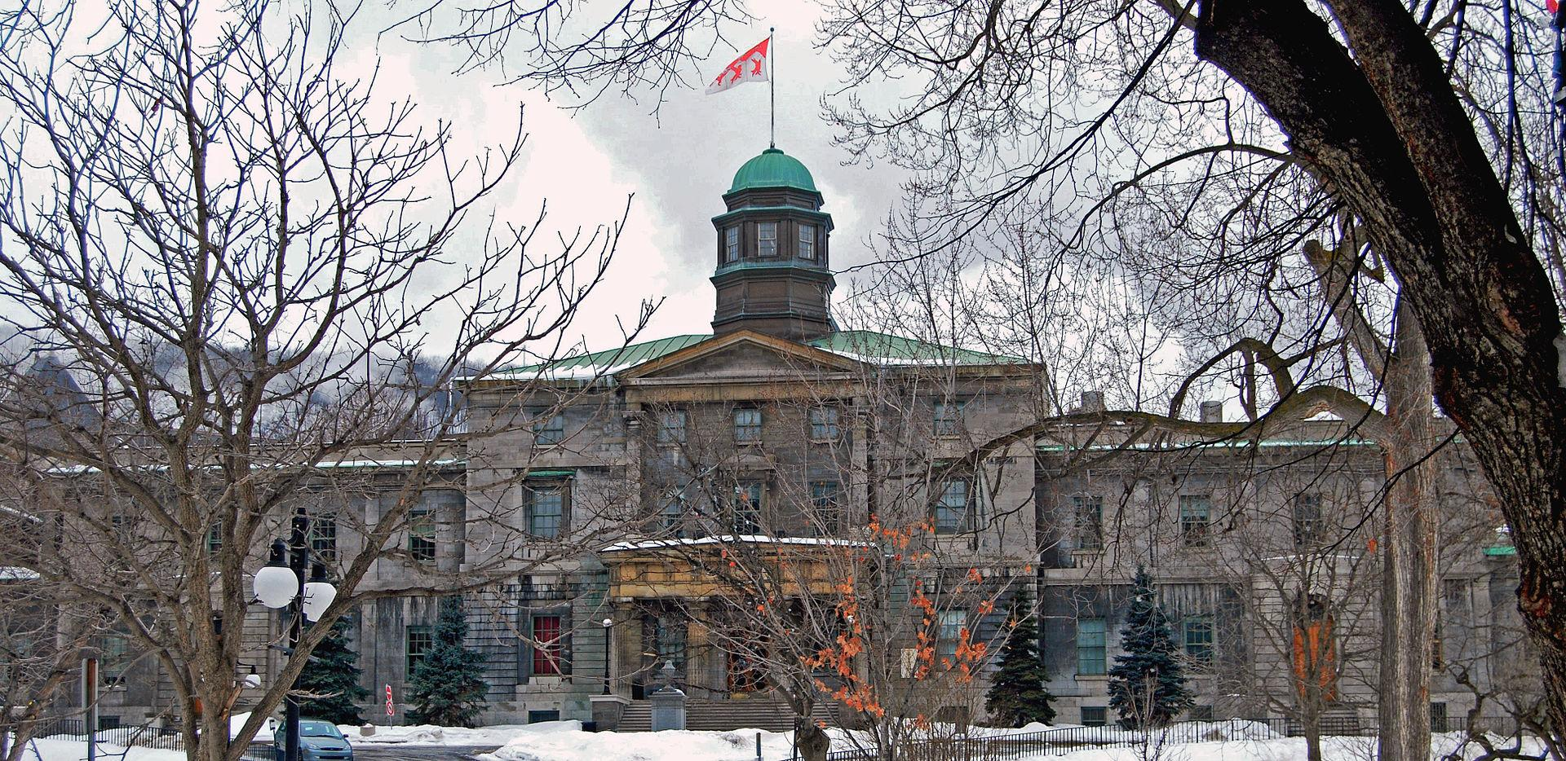
Notes:
I am from McGill University, in Montreal, Canada

Slide 3
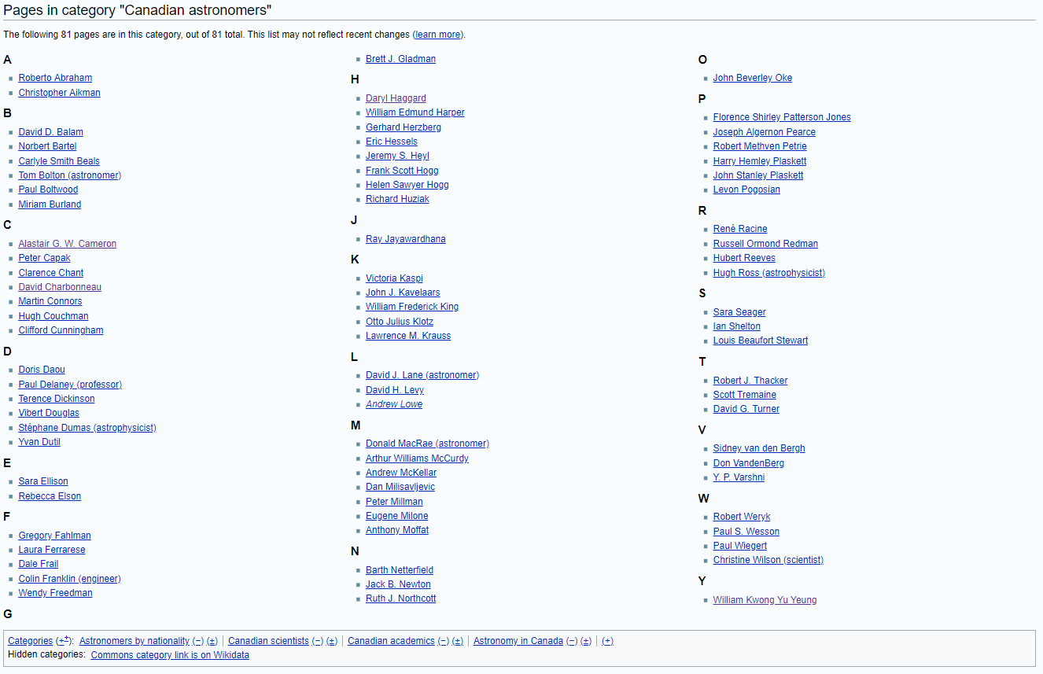
Notes:
I am a fairly experienced Wikipedia editor, and I’ve been slowly working my way through the list of Canadian astronomers, adding and improving articles.

Slide 4
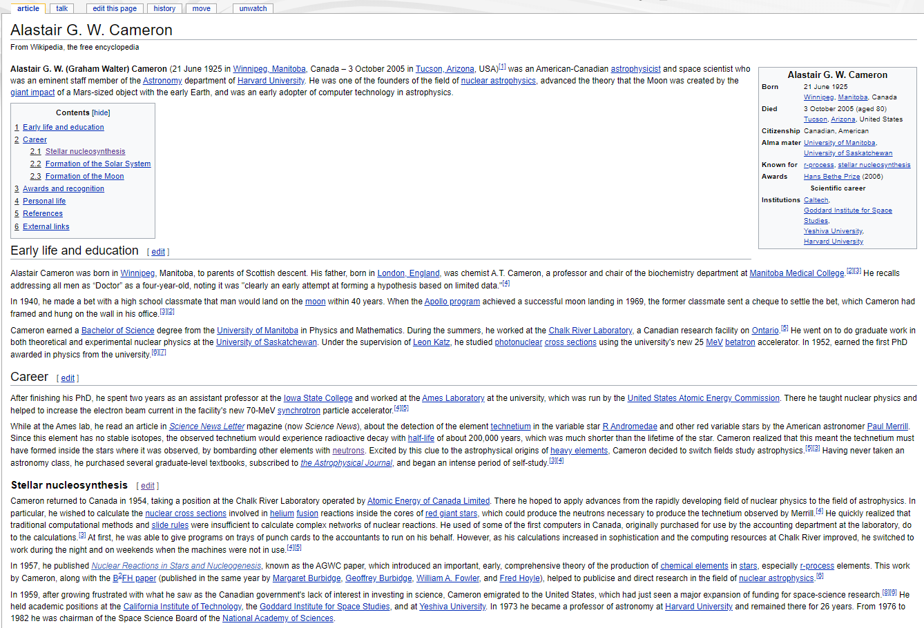
Notes:
For example, here is an articles that I significantly expanded.

Slide 5
Why Edit Wikipedia?

Slide 6
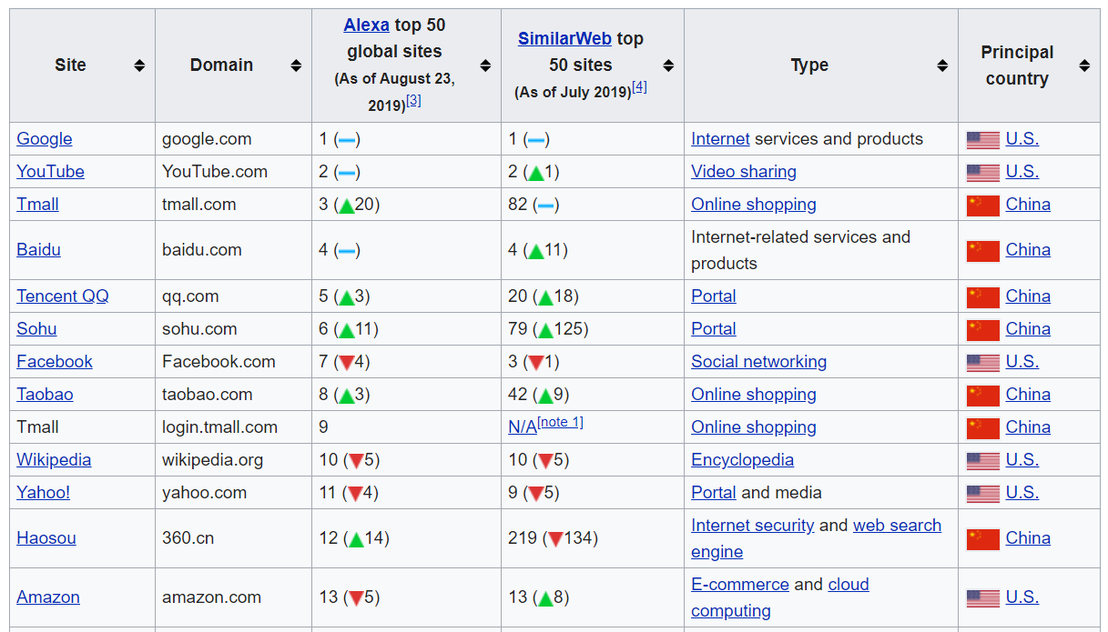
Wikipedia is the 10th most popular website worldwide
Notes:
This ranking varies, but Wikipedia is always in the top 10.

Slide 7
English Language Wikipedia
5,956,284 articles
~588 new articles per day
1.8 edits per second
37,432,943 Users
133,222 Users who have performed any action in the last 30 days
1,154 Administrators

Slide 8
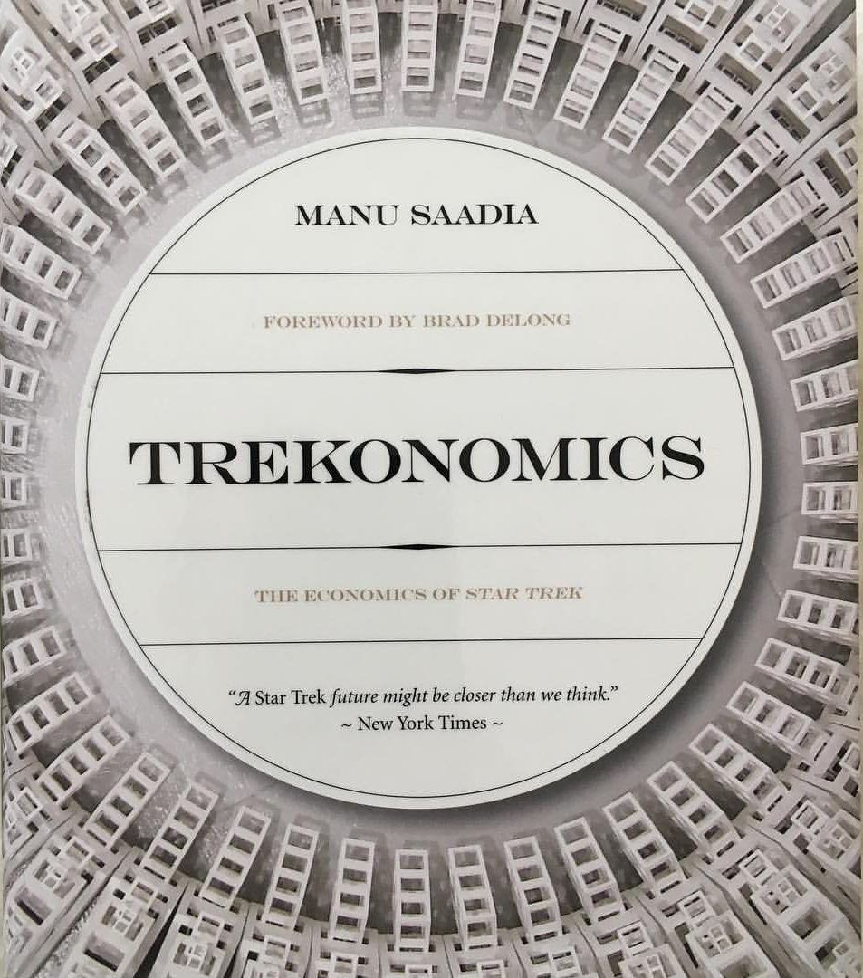
Notes:
I’m a huge Trekkie. One of the things that draws me to Wikipedia is that it one of the only spaces on the Internet that still works on utopian Star-Trek-like principles, where people work for prestige rather than money. Of the top 10 websites on the Internet, it is the only one run by a non-profit.

Slide 9
Wikipedia has a Diversity Problem

Slide 10
Biases
Gender:
18.07% of all biographies are of women
~ 16% of Wikipedia editors are female
Western:
~16% of content about sub-Saharan Africa is by Africans
Technologically Savvy
Notes:
As of 2019.

Slide 11
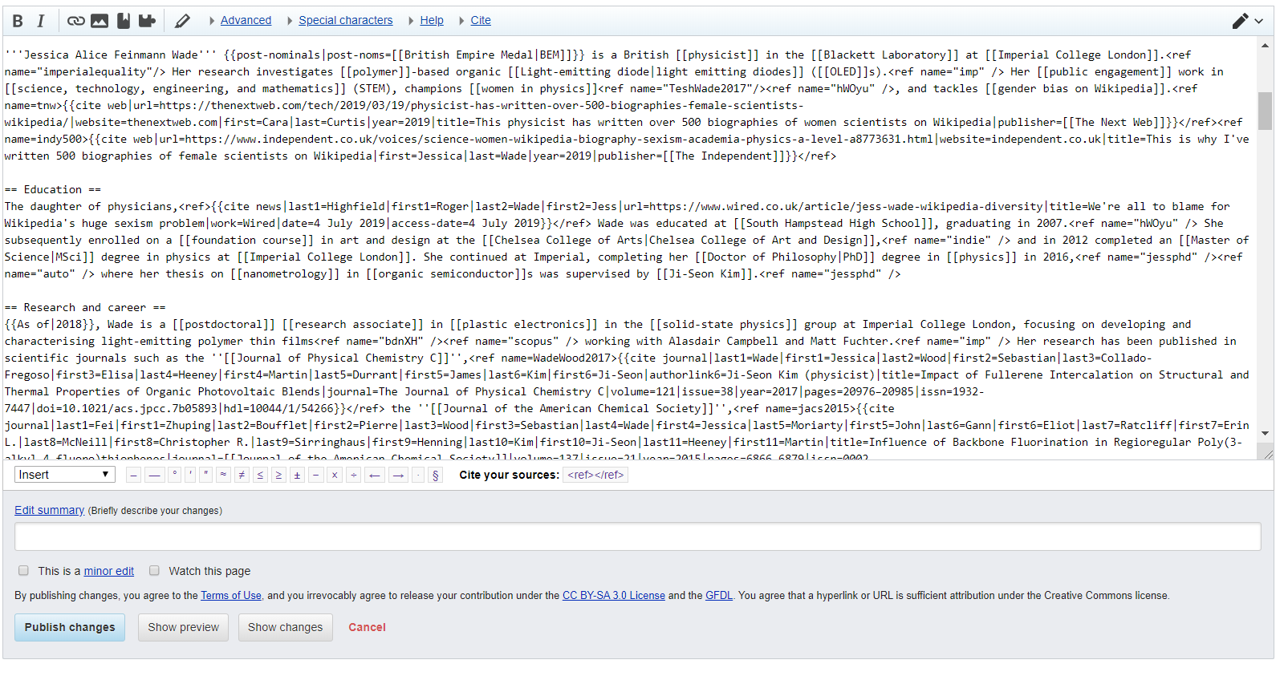
Notes:
Also, this is what the text looks like if you edit a page. It’s not exactly user friendly!

Slide 12
Biases
Gender:
18.07% of all biographies are of women
~ 16% of Wikipedia editors are female
Western:
~16% of content about sub-Saharan Africa is by Africans
Technologically Savvy

Slide 13
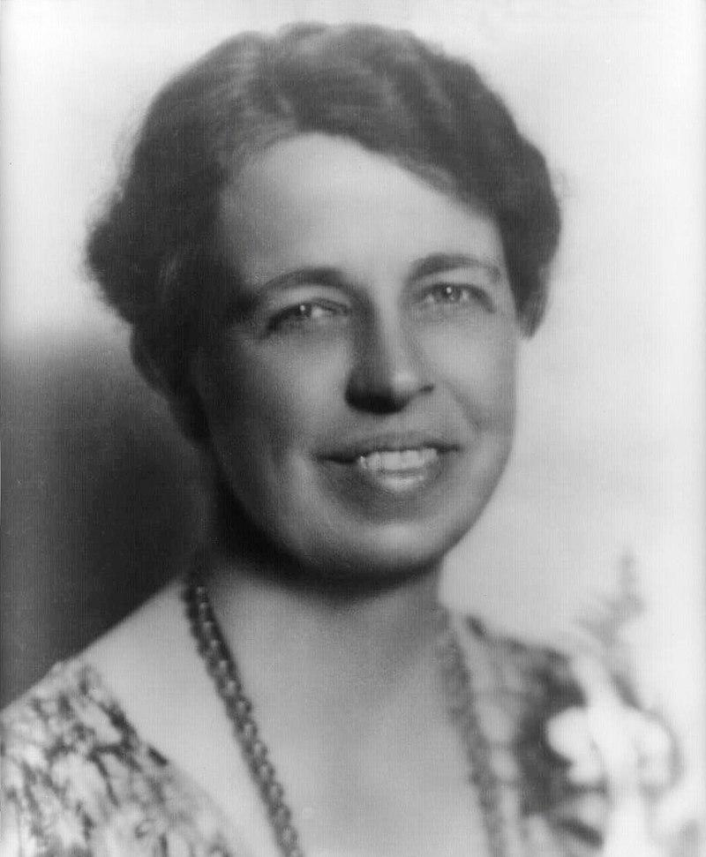

Eleanor Roosevelt
John Cena
Notes:
As of 2019. Let’s look at two Wikipedia pages. One for First Lady Eleanor Roosevelt and Professional Wrestler John Cena.

Slide 14
Eleanor Roosevelt
133,475 bytes
John Cena
220,733 bytes
Notes:
John Cena’s article is about twice the length of Eleanor Roosevelt, despite Roosevelt being a more important historical figure.

Slide 15
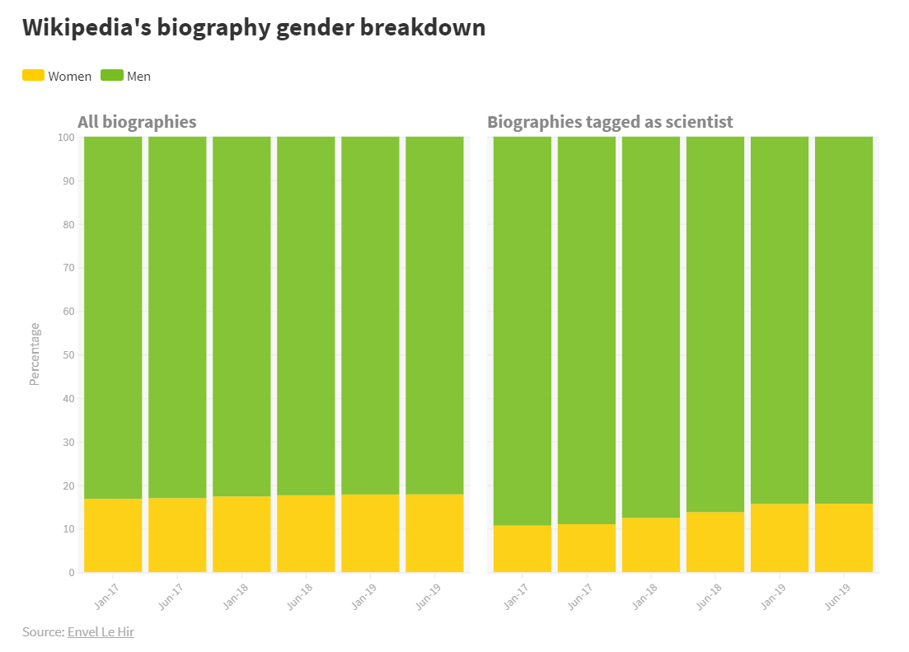
Visualization: Chemistry World

Slide 16
Notability
If a topic has received significant coverage in reliable sources that are independent of the subject, it is presumed to be suitable for a stand-alone article or list.
Notes:
One of the largest sticking points has been the subject of Notablitliy.

Slide 17

Clarice Phelps
Oak Ridge National Laboratory
Part of the team that discovered Tennessine
Notes:
Page created in September 2019 by Jess Wade, deemed “not Notable” and deleted by Wikipedia editors.

Slide 18

Jess Wade
Imperial College London
Photograph: Graeme Robertson/The Guardian
Notes:
600 articles she has written so far about female, black, minority ethnic or LGBTQ+ scientists

Slide 19
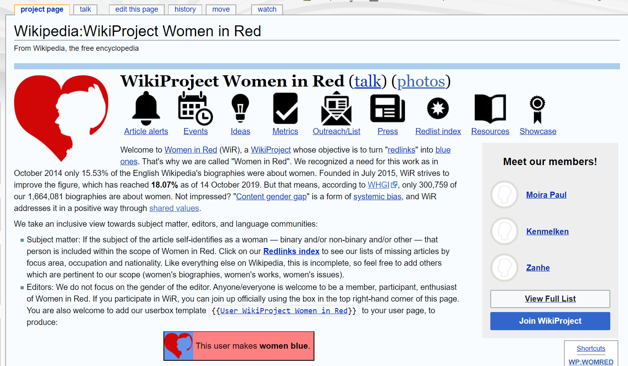

Slide 20
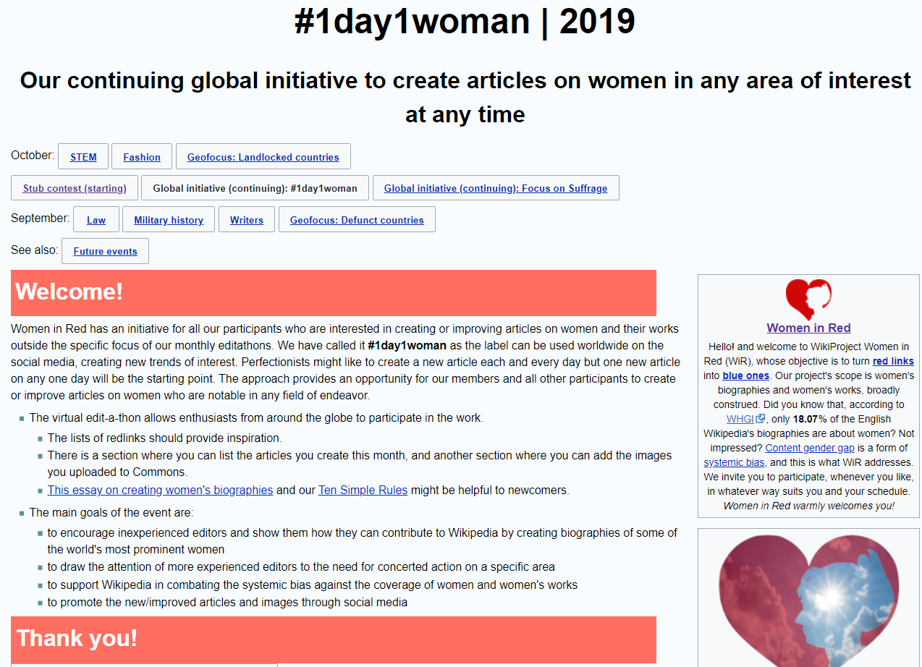

Slide 21

Sue Gardner
Former Wikimedia Foundation executive director

Slide 22
Reasons why women don't edit Wikipedia
A lack of user-friendliness in the editing interface
Not having enough free time
A lack of self-confidence
Aversion to conflict and an unwillingness to participate in lengthy edit wars
Belief that their contributions are too likely to be reverted or deleted
Some find its overall atmosphere misogynistic
Wikipedia culture is sexual in ways they find off-putting
Being addressed as male is off-putting to women whose primary language has grammatical gender
Fewer opportunities than other sites for social relationships and a welcoming tone
Notes:
According to Sue Gardner

Slide 23





The Five Pillars
Wikipedia is an encyclopedia
Wikipedia is written from a neutral point of view
Wikipedia is free content that anyone can use, edit, and distribute
Wikipedia's editors should treat each other with respect and civility
Wikipedia has no firm rules
Notes:
https://en.wikipedia.org/wiki/Wikipedia:Five_pillars

Slide 24
Neutral point of view
Verifiability
Articles must not take sides, but should explain the sides, fairly and without editorial bias. This applies to both what you say and how you say it.
All material must be attributable to reliable, published sources
Notes:
https://en.wikipedia.org/wiki/Wikipedia:Neutral_point_of_view
https://en.wikipedia.org/wiki/Wikipedia:Reliable_sources

Slide 25
No original research
Articles may not contain any new analysis or synthesis of published material that serves to reach or imply a conclusion not clearly stated by the sources themselves.
Notes:
https://en.wikipedia.org/wiki/Wikipedia:No_original_research

Slide 26
Wikipedia's editors should treat each other with respect and civility
Respect your fellow Wikipedians, even when you disagree
Seek consensus and avoid edit wars
Never disrupt Wikipedia to illustrate a point.
Act in good faith, and assume good faith on the part of others.
Be open and welcoming to newcomers.
Notes:
Should conflicts arise, discuss them calmly on the appropriate talk pages, follow dispute resolution procedures, and consider that there are 5,956,028 other articles on the English Wikipedia to improve and discuss.
https://en.wikipedia.org/wiki/Wikipedia:Civility

Slide 27
Introduction to Editing

Slide 28
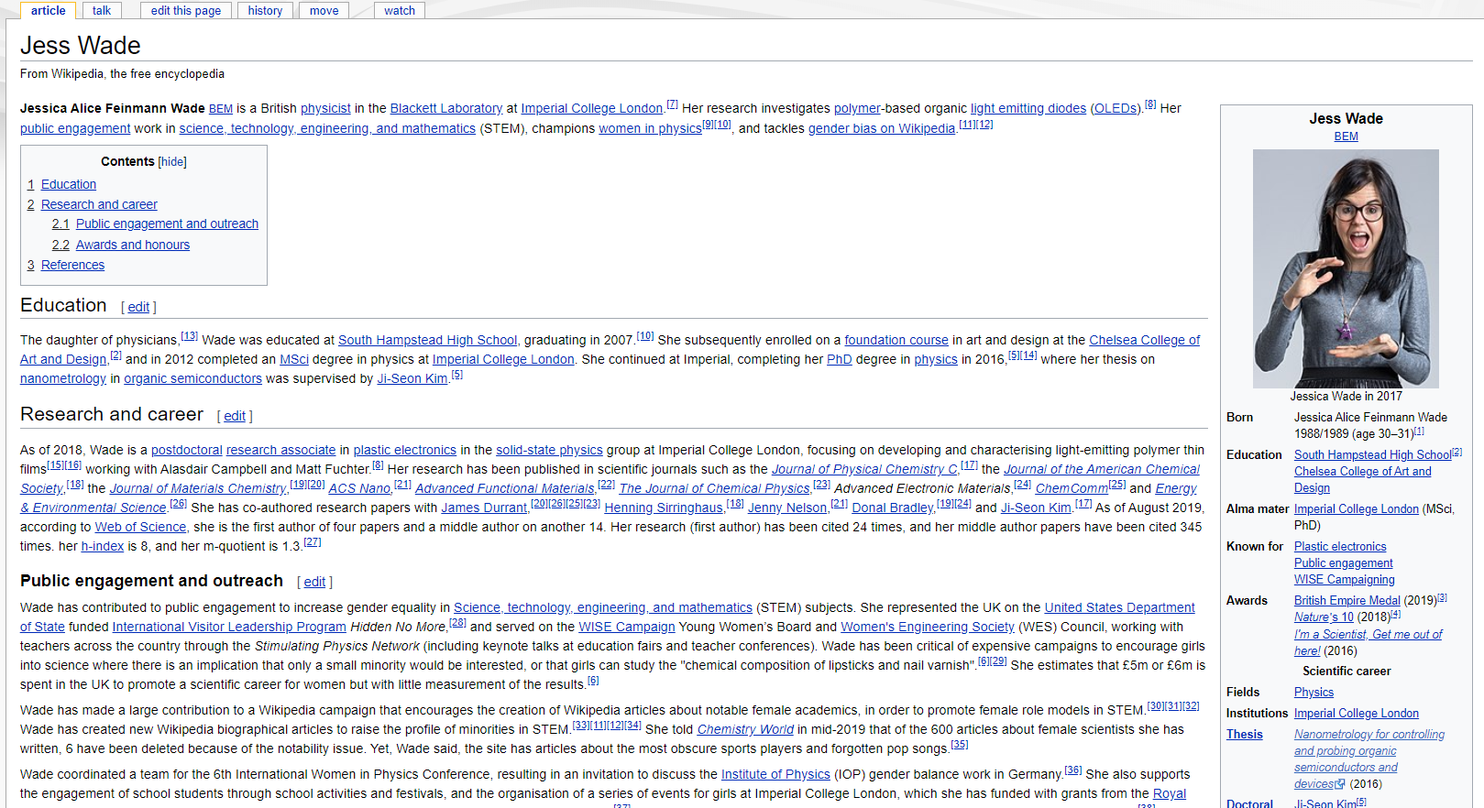
Notes:
To begin, click on the “edit this page” tab at the top of any article.
This example uses:
https://en.wikipedia.org/wiki/Jess_Wade

Slide 29
Notes:
You will see a bunch of code in “WikiText”, which includes the article text, and code for things like headers, links, references, and images.

Slide 30
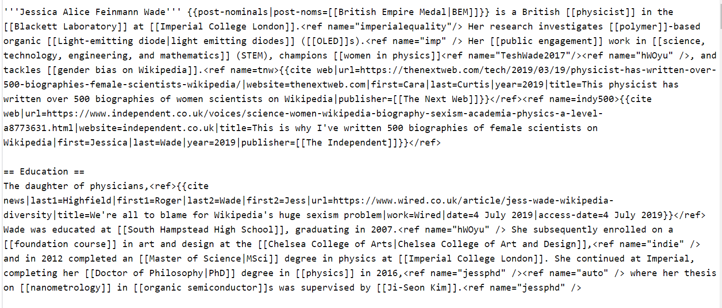
Notes:
Here is a section for this page

Slide 31
Wikitext Cheat Sheet
Italics, bold, and both | ''italics'', '''bold''', and '''''both''''' | italics, bold, and both
Link to another page | [[copy edit]] [[copy edit]]ors | copy edit copy editors
Link to another page, different link text | [[Android (operating system)|Android]] | Android
Link to a section | [[Frog#Locomotion]] [[Frog#Locomotion|locomotion in frogs]] | Frog#Locomotion locomotion in frogs
Notes:
And and here is a what all of those symbols mean

Slide 32
Wikitext Cheatsheet
Plain website | https://www.wikipedia.org | https://www.wikipedia.org
Link and name a website | [https://www.wikipedia.org/ Wikipedia] | Wikipedia
Sign a talk page | ~~~~ | Username (talk) 01:58, 21 October 2019 (UTC)

Slide 33
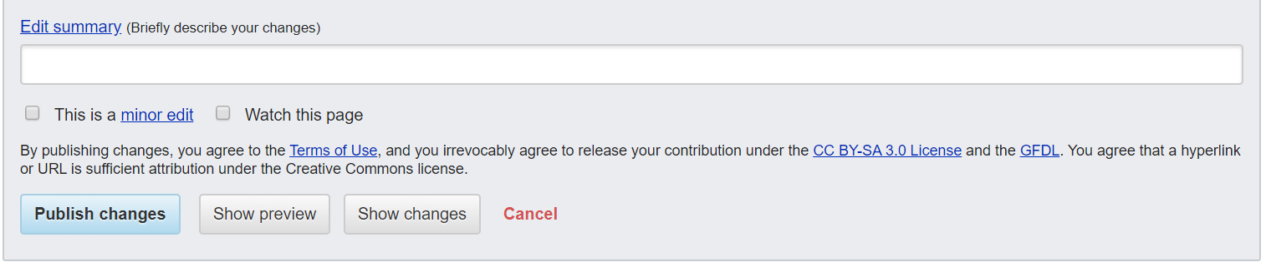
Notes:
Checking the minor edit box signifies that the current and previous versions differ only superficially (typographical corrections, etc.), in a way that no editor would be expected to regard as disputable.
Any edit that changes the meaning of an article is not a minor edit, even if the edit concerns a single word, and it is improper to mark such an edit as minor.

Slide 34
Notes:
But here is the real secret. You can (mostly) ignore the Wiki syntax and edit with a WYSIWYG editor instead. This is the visual editor. Click on the the pencil icon at the top to get to the “visual editor”.

Slide 35
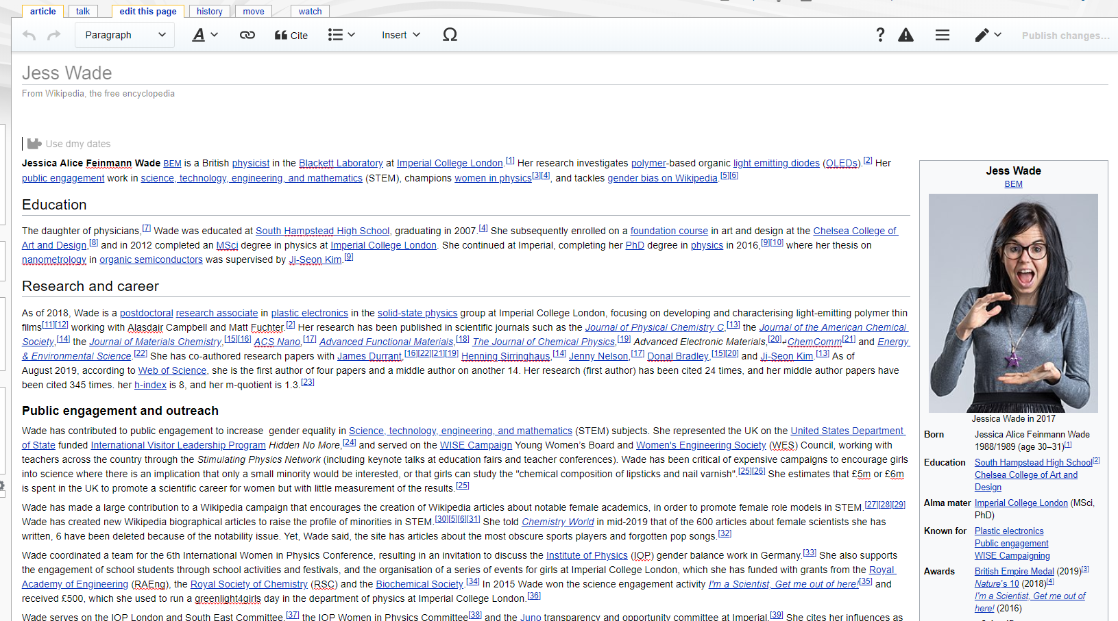
Notes:
It looks like this. Much better!

Slide 36
How to Get Started

Slide 37
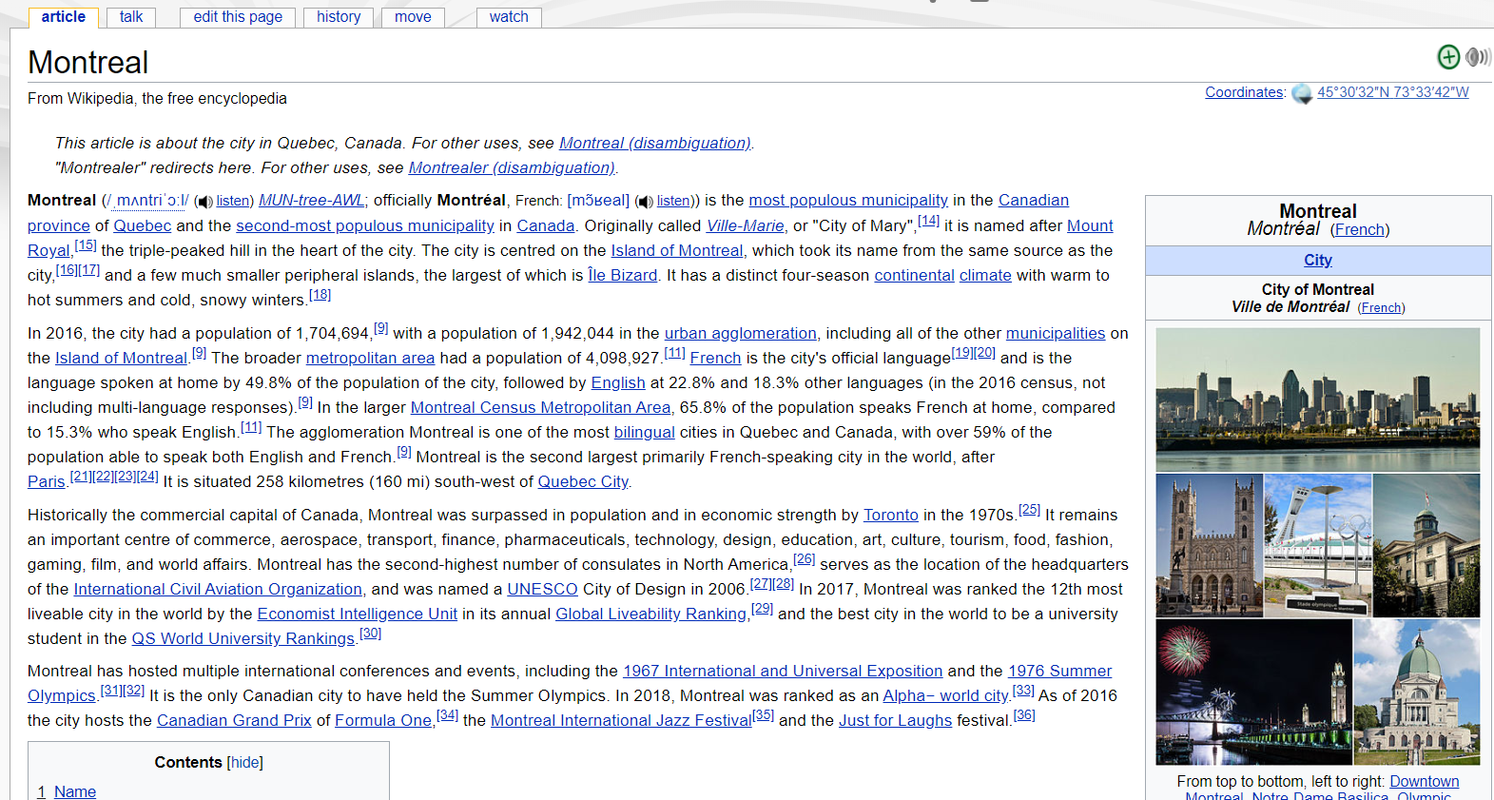
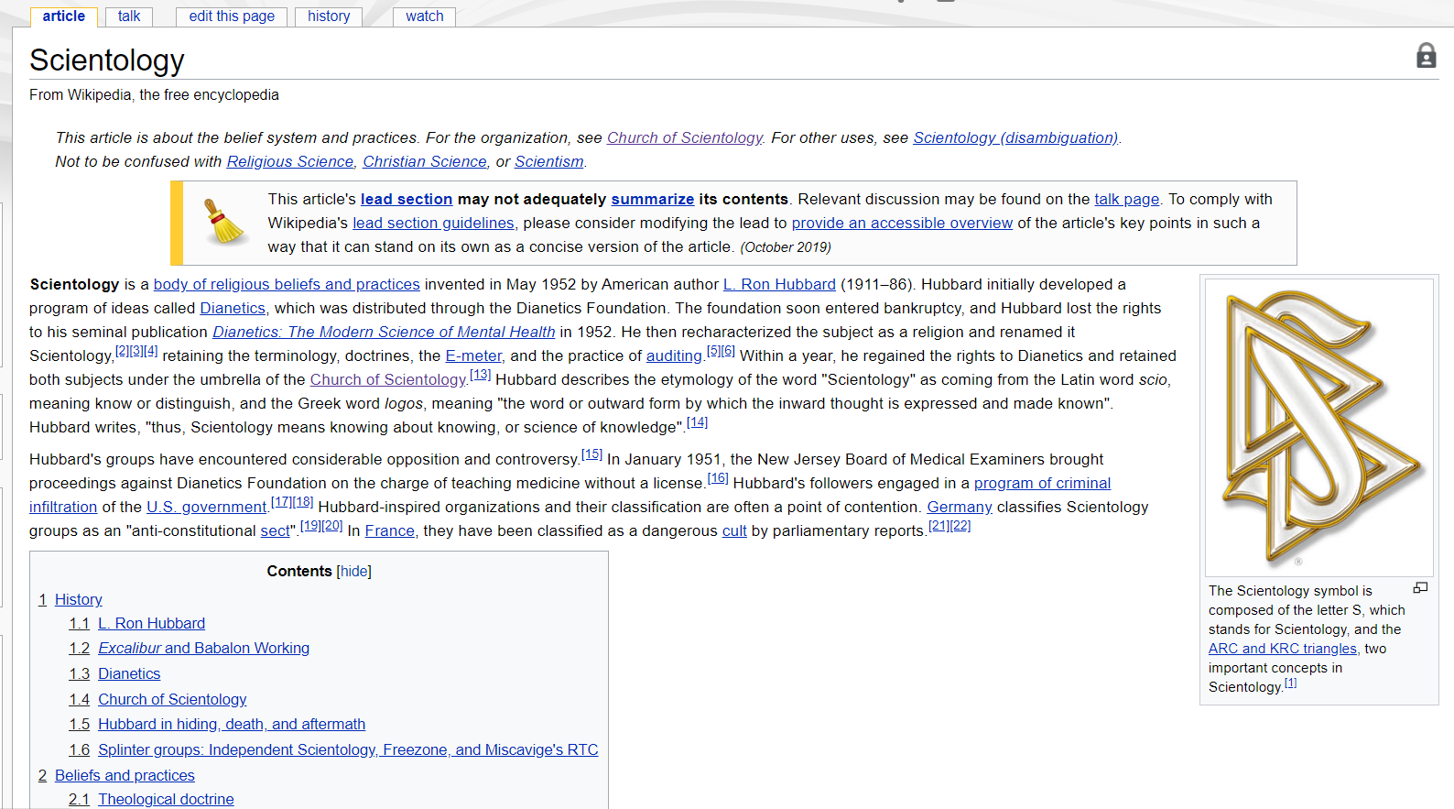
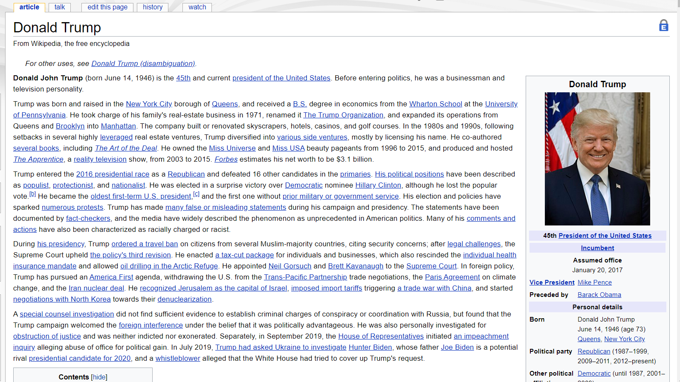
Notes:
It might be tempting to start out editing a well-known or controversial page. Let the world know what you think!

Slide 38
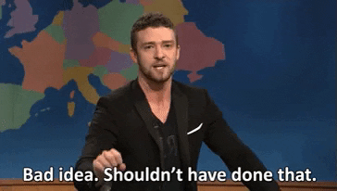
Notes:
This is a bad idea. Your edits will almost certainly get reverted. As a novice editor, you may even be locked out of editing some pages that often get vandalized.

Slide 39
Conflict of interest (WP:COI)
Contributing to Wikipedia about:
Yourself
Family and friends
Clients and employers,
Or your financial and other relationships
Notes:
Don’t edit topics that violate the conflict of interest policy.

Slide 40
Good Places to Start
Choose a topic that is well known in your discipline, but only weakly represented on Wikipedia.
Look for articles considered “stub” or “start” class on Wikipedia’s internal quality scale. You can see an article’s rating by visiting its talk page.
Start with a reference
Upload a photo to Wikimedia Commons
Translate a page into another language

Slide 41
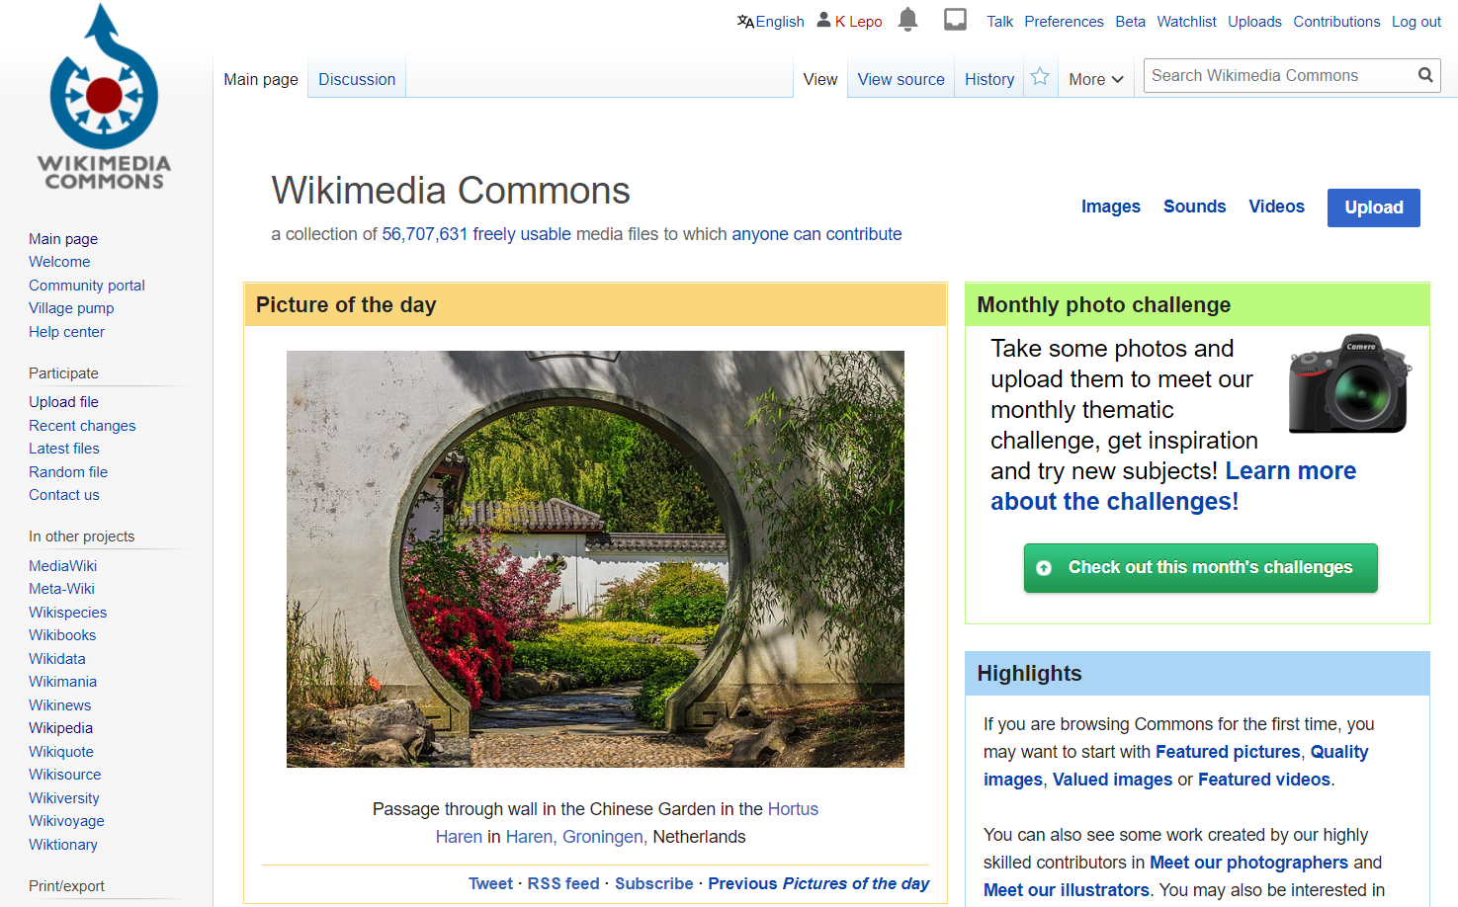
Notes:
https://commons.wikimedia.org/wiki/Main_Page

Slide 42
Good Places to Start
Choose a topic that is well known in your discipline, but only weakly represented on Wikipedia.
Look for articles considered “stub” or “start” class on Wikipedia’s internal quality scale. You can see an article’s rating by visiting its talk page.
Start with a reference
Upload a photo to Wikimedia Commons
Translate a page into another language

Slide 43
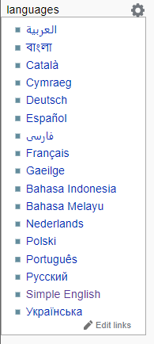
Notes:
Click on the sidebar of any article to see it in other languages.

Slide 44
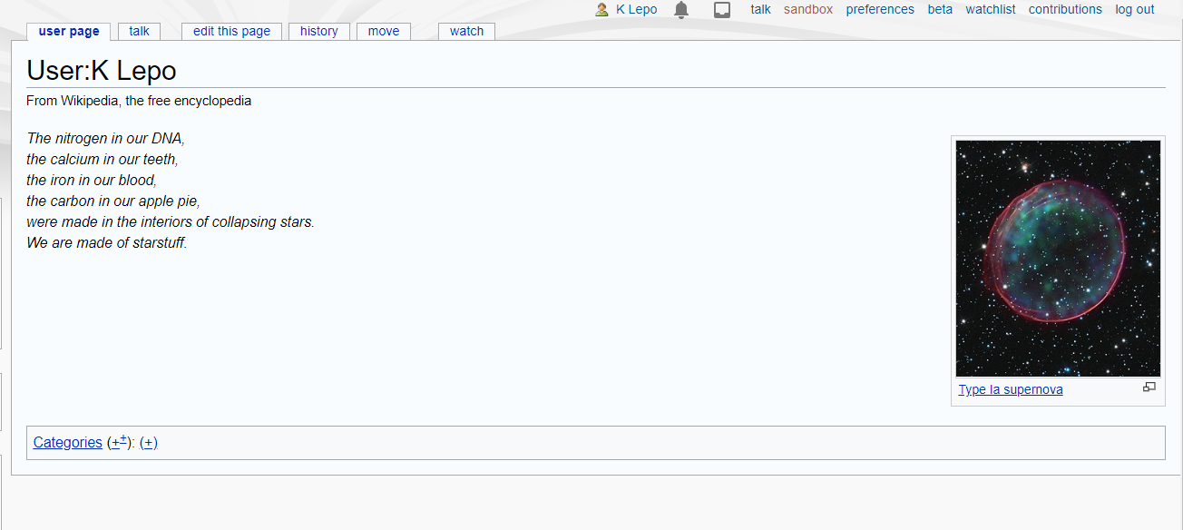
Notes:
This is your user page. After you create an account, you can get to it by clicking on your user name at the top navigation bar.

Slide 45
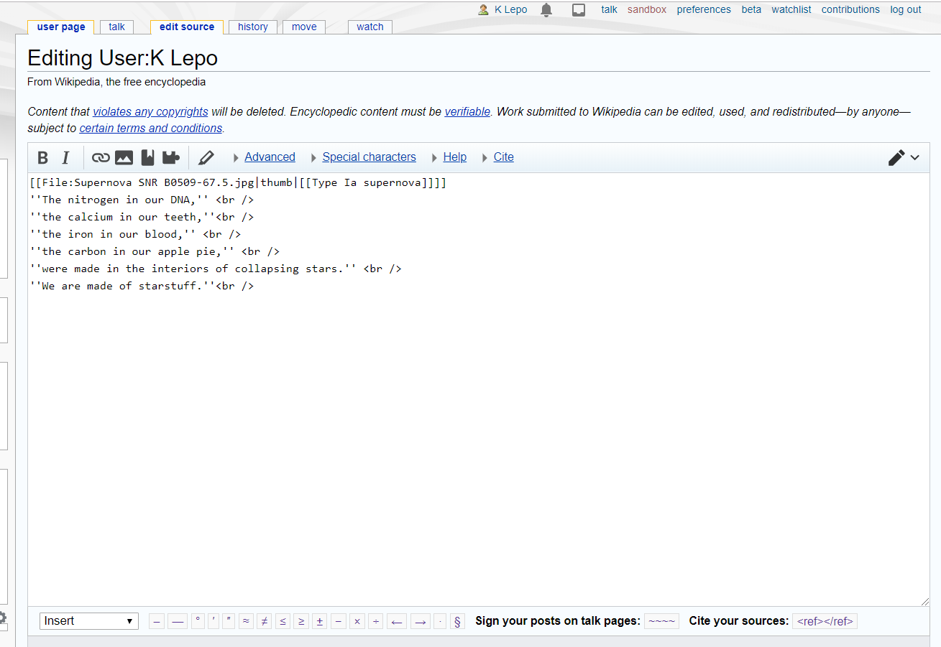
Notes:
You can practice editing by filing in your own user page. You can put whatever you want here. Some people use it to declare their conflicts of interest.

Slide 46
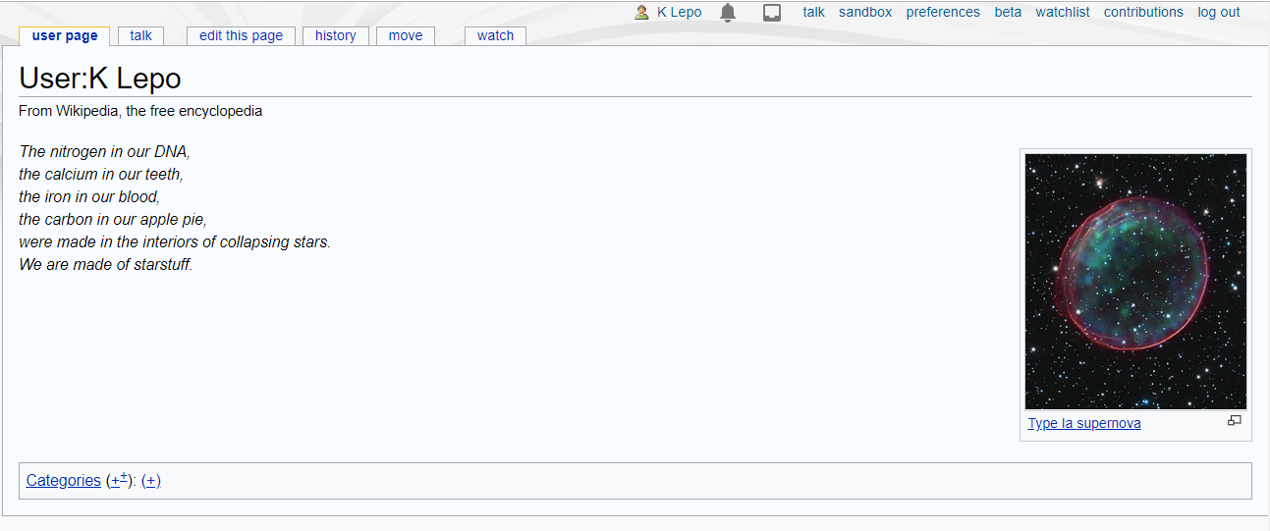
Notes:
You also have a sandbox. You can start or edit copied text from articles here before transferring them to the main Wikipedia space.

Slide 47
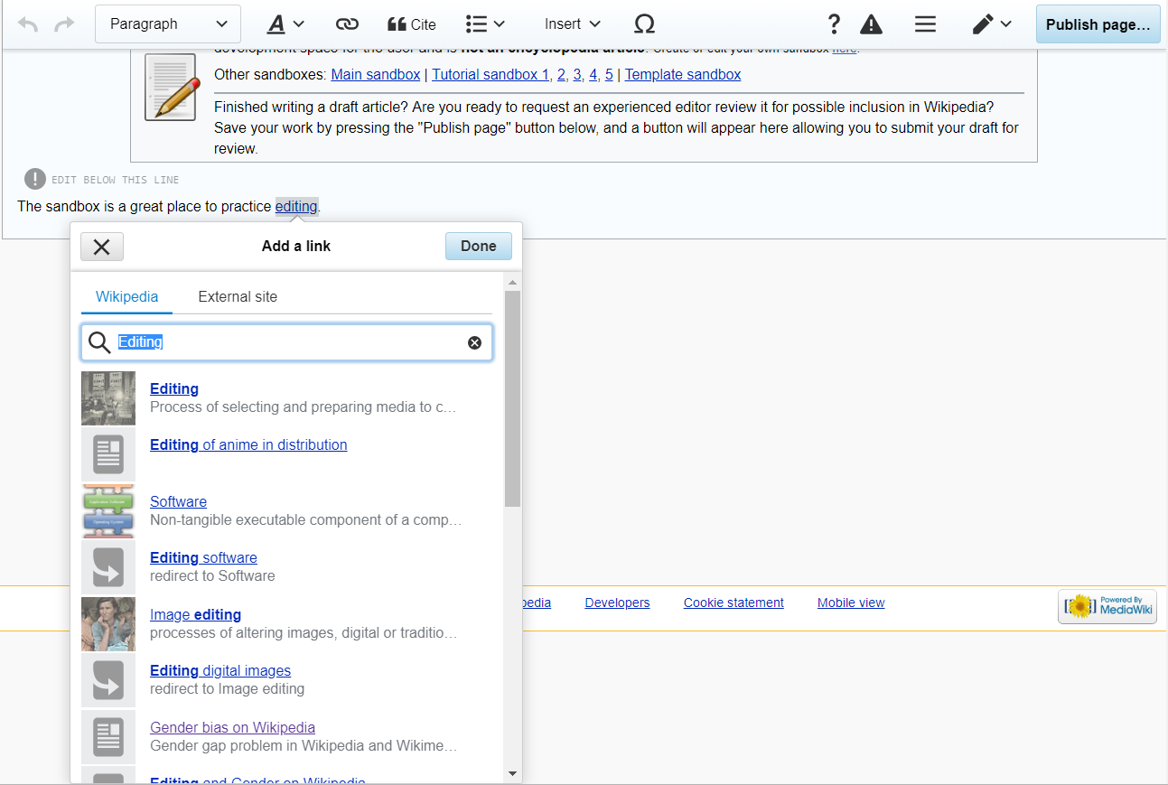
Notes:
At the top of the page, there is a button for inserting links (when working in the visual editor)

Slide 48
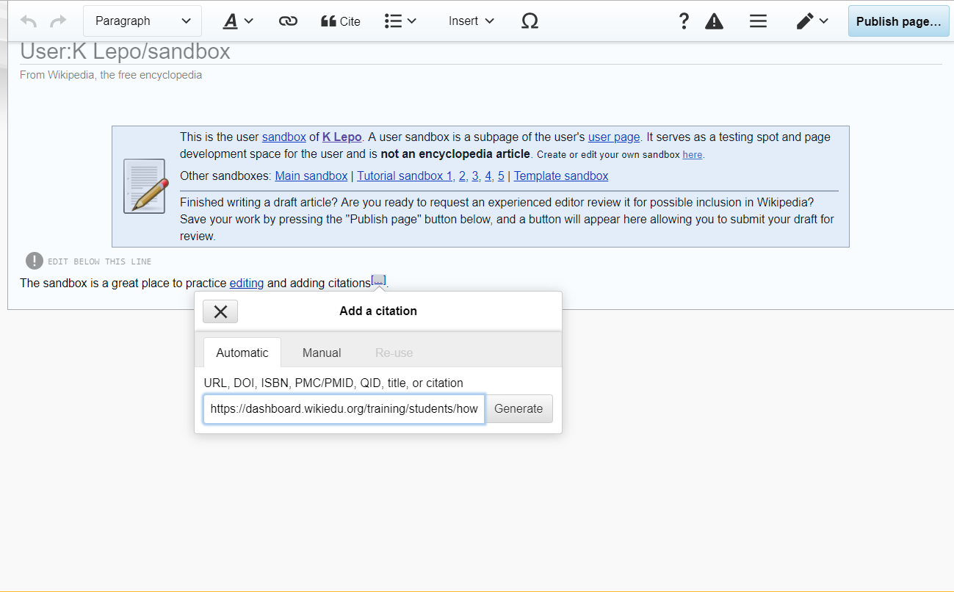
Notes:
And citations

Slide 49
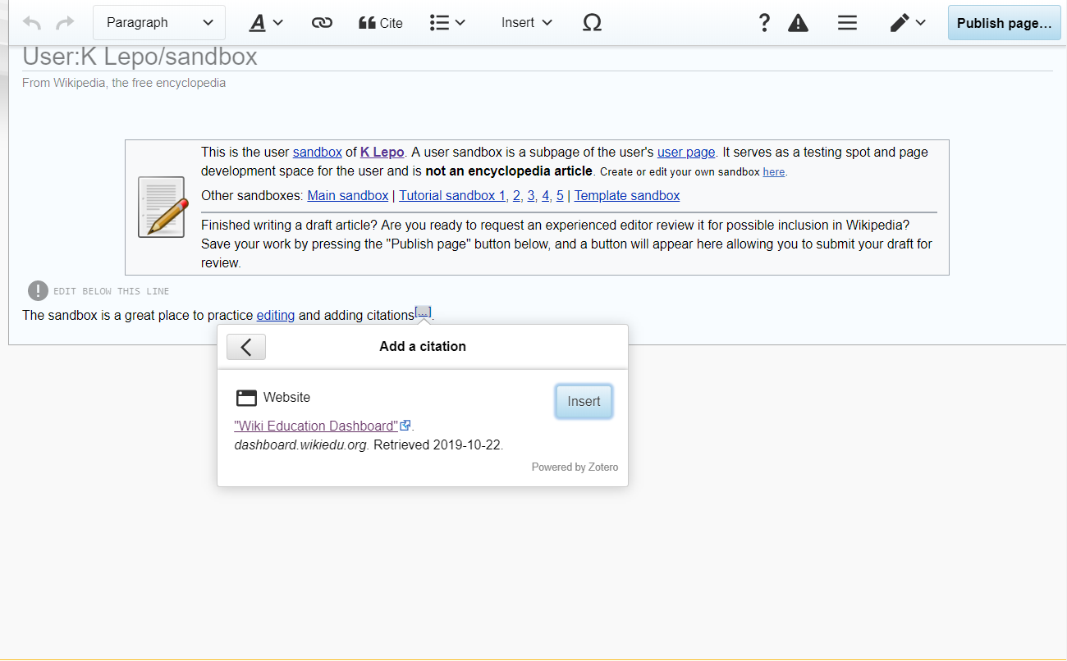

Slide 50
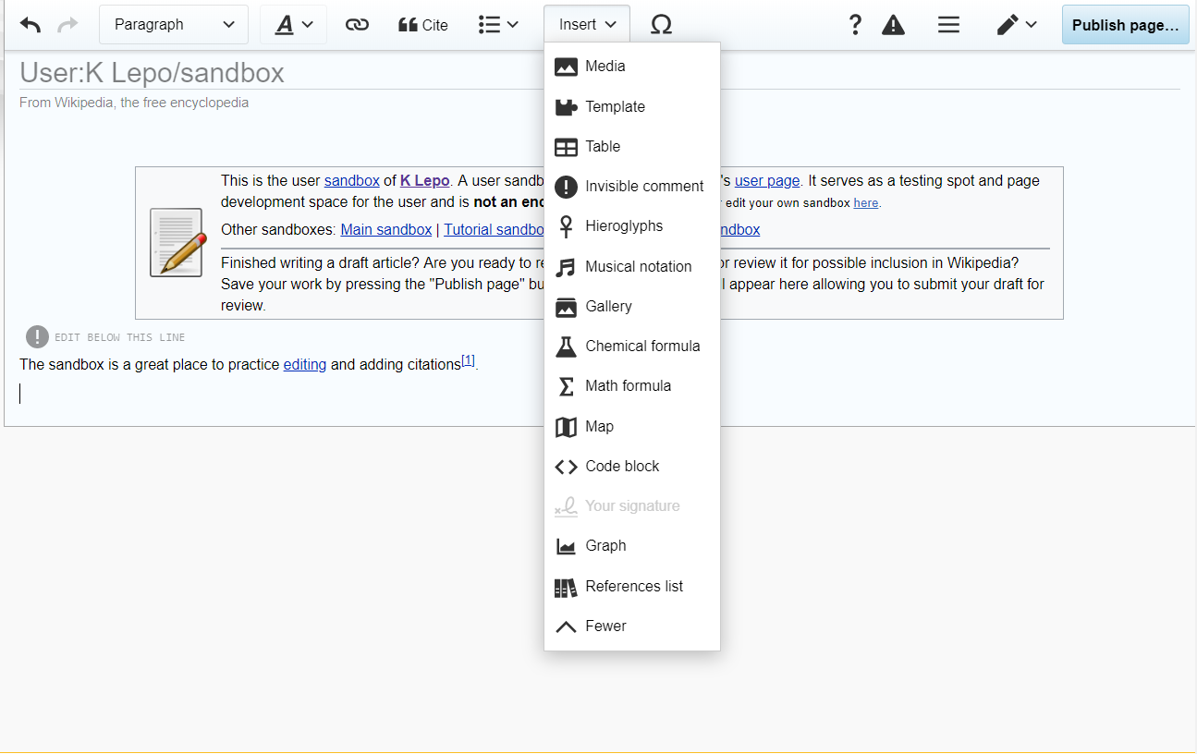
Notes:
Add a reference list from the Insert menu

Slide 51
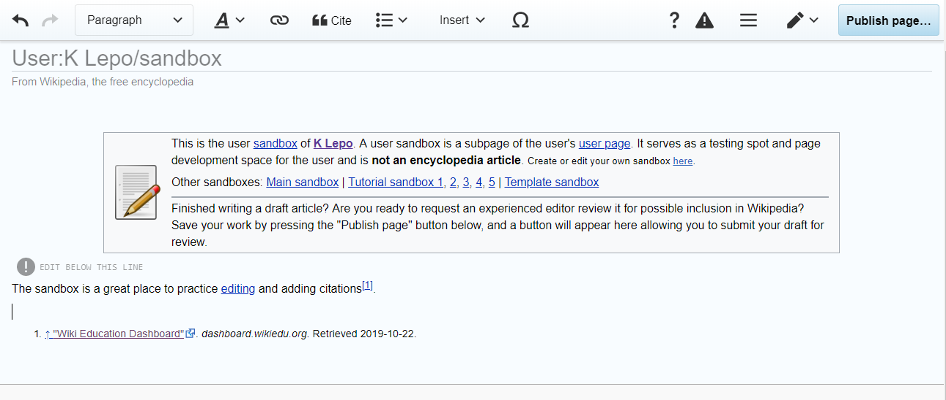

Slide 52
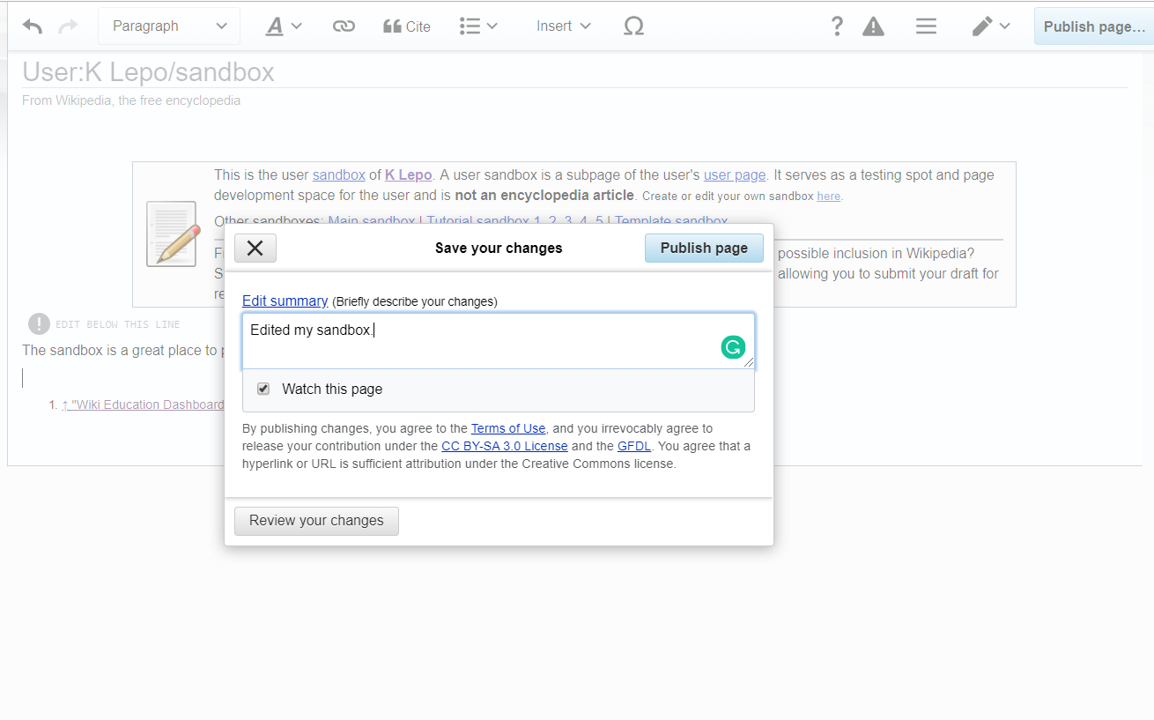
Notes:
And say what changes you made.

Slide 53
Be Bold!

Slide 54
You can help add to the world's knowledge by becoming a Wikipedia editor
Wikipedia's content reflects the biases and interests of its editors
The visual editor helps you contribute without dealing with Wikipedia's syntax
Start small and help improve new pages before starting new ones

Slide 55
Notability
Notes:
One way to avoid getting your page deleted, is to know the Notability rules. Early drafts should establish the notability of your subject, the rest of the details can be filled in later.

Slide 56
Notability Guidelines
for Academics (WP:ACADEMIC)
Named a chair or distinguished professor at a major institution of higher education and research
Elected or appointed highest-level administrative post at a major academic institution or major academic society.
Had a substantial impact outside academia in their academic capacity.
Head or chief editor of a major, well-established academic journal in their subject area.
Notes:
The Notability Guidelines (like professors):
https://en.wikipedia.org/wiki/Wikipedia:Notability_(academics)

Slide 57
Notability Guidelines
for Academics (WP:ACADEMIC)
Research has had a significant impact in their scholarly discipline
Received a highly prestigious academic award or honor at a national or international level
Elected member of a highly selective and prestigious scholarly society or association or a fellow of a major scholarly society which reserves fellow status as a highly selective honor.

Slide 58
Notability Guidelines
for Astronomical Objects (WP:NASTRO)
Is, or has been, visible to the naked eye.
Is listed in catalogues of interest to amateur astronomers (e.g. Messier catalogue, Caldwell catalogue), or a catalogue of high historical importance (e.g. New General Catalogue). Being listed in comprehensive databases (e.g. SIMBAD or NED) and surveys (e.g. 2MASS or 2dFGRS) isn't enough for notability.

Slide 59
Notability Guidelines
for Astronomical Objects (WP:NASTRO)
Has been the subject of multiple, non-trivial published works (newspaper articles, books, television documentaries and articles in peer-reviewed scientific journals).
The object was discovered before 1850, prior to the advent of stellar astrophotography or automated technology.

